Slide 1
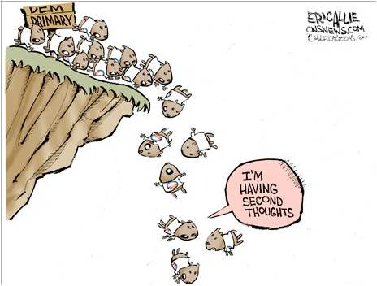
Collective Behavior
http://www.youtube.com/watch?v=zCJzcS1BugQ&safe=active Social Psychology Big Bang Theory

Slide 2
http://www.iterated-prisoners-dilemma.net/
Prisoner's dilemma
http://serendip.brynmawr.edu/playground/pd.html
Prisoner's dilemma
http://www.clickondetroit.com/news/Viral-stunt-may-have-gone-to-far/-/1719418/19209970/-/format/rss_2.0/-/i5ubjdz/-/index.html
virtual stunt gone to far
https://www.youtube.com/watch?v=Mfg6R0Gjz54
Jimmy Kimbel – smell phone
https://www.youtube.com/watch?v=rdIWKytq_q4
Jimmy Kimbel – I phone 5s
http://www.youtube.com/watch?v=i4lkx8Ewcj4
Made up rap bands https://www.youtube.com/watch?v=W_IzYUJANfk
Made up bands

Slide 3
Think about the articles that we have read about Josh, Kitty Genovese, the Richmond High Rape… and the Human Zoo video. How do you see the following concepts illustrated by the examples we have discussed in class?

Slide 4
Society and Group Influences
Whether you realize it or not, the society in which you live as well as the different groups to which you belong have a big impact on how you behave.

Slide 5
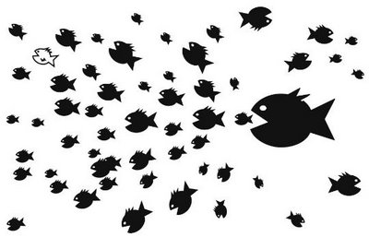
Picture #1
It's clear that the little fish here, have a problem. What's also clear, is that random actions of an individual fish are not likely going to change the situation.

Slide 6
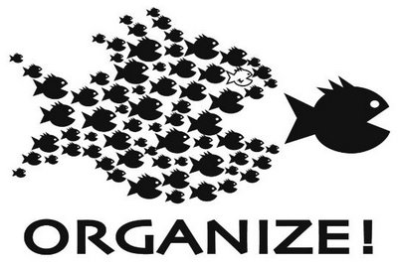
In the next picture, by coordinating behavior, a way has been found to solve 'the problem' :

Slide 7
What is a Group?
A group is more than just a collection of individuals who happen to be in the same place at the same time.
To be a group in this sense, two or more individuals must:
Interact with each other
Share a common goal
Have a relationship that is fairly stable over time
Be independent
Recognize a relationship between themselves

Slide 8
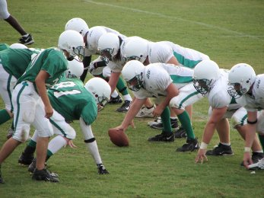
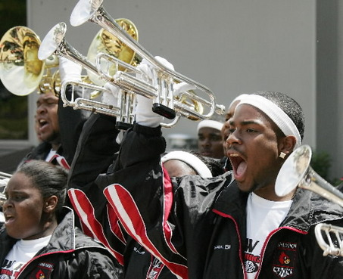
What is a Group? Continued…
You may belong to a number of groups.
Your family, a sports teams, a church group, or an after-school club.
Each group has certain standards of behavior called norms.

Slide 9
Norms
Norms are spoken or unspoken rules that tell us how we should behave – that is, how others expect us to behave.

Slide 10
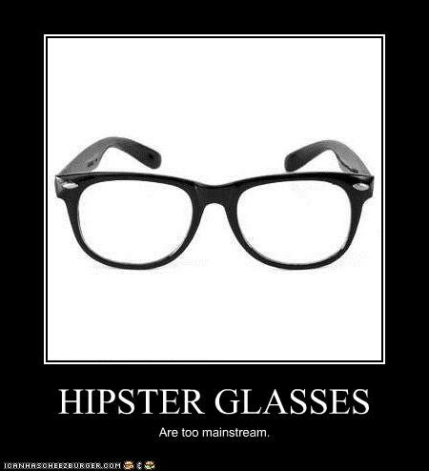
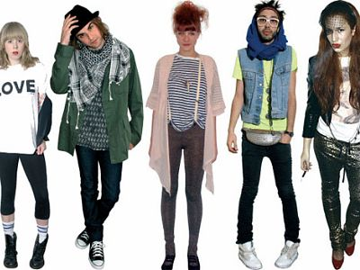
Norms affect how we dress, talk, and act.

Slide 11
Norms in Different Cultures
Social behavior varies among cultures because different cultures have different social norms.
Example: American culture places a high value on being on time. Many other cultures have no such value.
Norms include everything from dating habits to ideas about modesty to child-rearing practices.

Slide 12
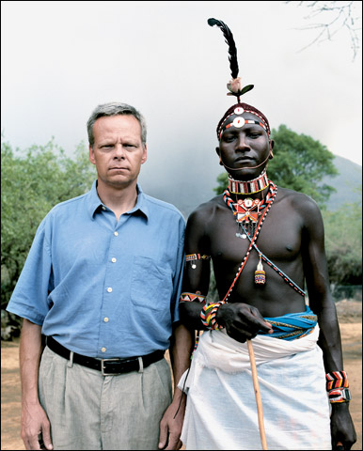
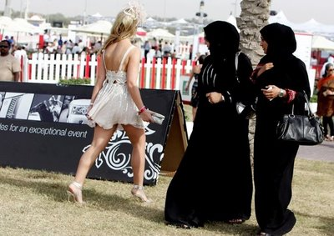
When people from different cultures come together, they may experience a culture clash because they have different expectations about how people should behave.

Slide 13
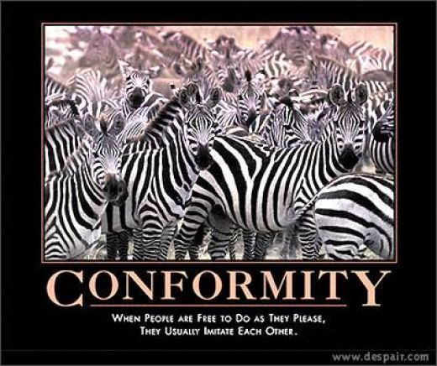

Slide 14
Conformity
Conformity refers to adopting attitudes or behaviors that reflect the social norms of a group.
Although social norms might seem to limit our choices and our self-expression, most people conform to most social norms.
Why do we feel a need to “go along with the crowd”?
Psychologists cite two reasons we conform:
1. We want to be liked.
2. We want to be right.
https://www.youtube.com/watch?v=NyDDyT1lDhA
Asch Experiment

Slide 15
Why do we conform?
We conform when we acknowledge rules of fair play or discussion, keeping our interactions from chaos.
By behaving toward others as we are expected to, we promote group harmony.
Dressing as others do, laughing at the same jokes, or even supporting the same political views often helps us feel that we “belong.”
Agreeing with others, even if they are wrong, prevents us from being wrong by ourselves.

Slide 17
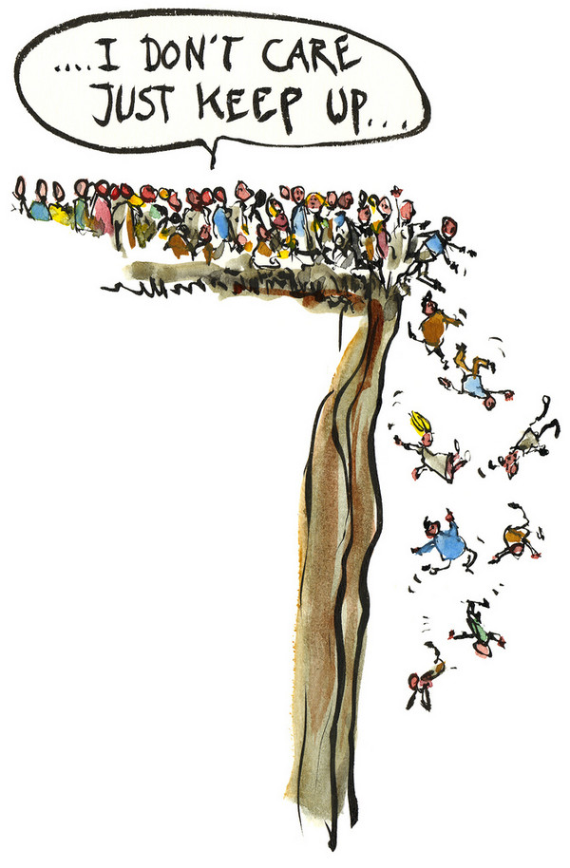

Slide 18
Why do we choose not to conform?
Although we crave a sense of belonging and a desire to be like others, we also want to feel we are individual and unique.
The act of emphasizing our individuality is called individuation.
When we recognize that we’ve been pressured to adopt attitudes or behaviors in which we do not believe or that we feel may be harmful, we may choose to change groups rather than conform.

Slide 19
When are you most likely to conform?
Research has found that…
We are more likely to conform if we like the people exerting the influence and want to be liked by the group.
The larger the group, the more likely we are to conform to it.
We are less likely to conform if the group is not strongly unanimous, so that we may find support for a differing view.

Slide 20
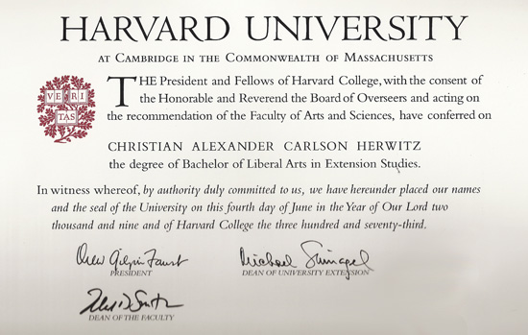
Cooperation and competition
Cooperation and competition are important dimensions of human interaction.
Example: Consider the classroom…
You, your classmates and teacher cooperate with each other so that you can learn. Students also compete with each other. Students who outperform their classmates can reap a variety of benefits, from increased status to acceptance at top universities.

Slide 21
What incentives do we have to cooperate?
Humans are social being. We live together in cooperative societies or work cooperatively in groups because such arrangements offer many benefits:
Performance of Tasks: Cooperation allows us to perform tasks that we couldn’t perform by ourselves.
Access to Information or Resources: Cooperation can give us access to information or resources we would not have access to otherwise.
Safety in Numbers: This incentive is important not just for physical security but in battling any “enemy.” (EX. Two political parties may cooperate with each other to defeat a third party).
Division of Labor: Instead of everyone doing each part of a task, each person can focus on what he or she does well and then share results.

Slide 22
What Incentives do we have to be Competitive?
Despite these strong incentives to cooperate, in many situations we have more to gain by competing with and succeeding over others:
More or better resources: Through successful competition, we may be able to win more or better resources.
Status: Successful competition, either by itself or because of its rewards, can earn us a higher status in our group.
Power or Authority: By competing with others, an individual may achieve power or authority and the ability to assume a leadership position.
Individual Achievement: We may compete to satisfy our need for individual achievement.

Slide 23
Social Dilemmas
What if someone has more to gain by being selfish when everyone else cooperates?
Example: If everyone used public transportation, air pollution would decrease. But if most people agree to use public transportation and you continue to drive, you reap the advantages of both decreased air pollution and the convenience of your own transportation.
Do you act with social responsibility, for the good of the group, or do you act selfishly?
The conflict between wanting to do what is best for the group and what is best for oneself is called a social dilemma.

Slide 24
Movements Toward Social Responsibility
People may be encouraged to work together for the common good if they:
Understand that they share that same outcome with everyone else.
Realize an individual benefit.
Acknowledge that when many small individual contributions come together, they result in a significant outcome.
Example: We may collectively solve the pollution problem when we realize that pollution affects each of us, take advantage of individual benefits such as speedier carpool lanes, and recognize the importance of our individual efforts.

Slide 25
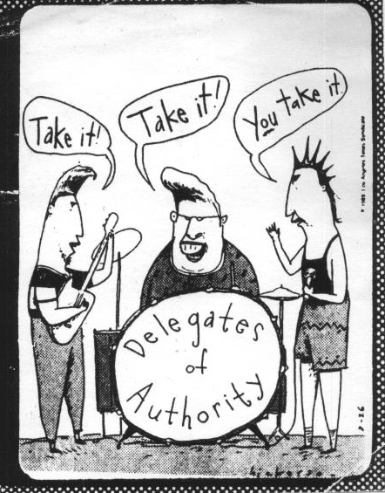
Group Dynamics
Group members interact in ways that influence each other and the group itself.
Group dynamics describes how
groups behave – the factors that
affect group decision making,
how group roles function, and how different leadership styles affect the group.

Slide 26
Making Decisions
Whether we are members of a social club or a cabinet of presidential advisors, we often must make decisions as a group.
To arrive at a group decision, members start out with individual decisions from which they must eventually reach a consensus.
Several other factors can also influence the decision-making process.

Slide 27
Group Polarization
Important decisions are often made by a committee because common wisdom holds that group decisions should be less extreme than individuals decisions.
According to extensive research by Eugene Burnstein, what happens in reality is often exactly the opposite.
Research indicated that groups tend to make the more extreme decisions, whether riskier or more conservative, than any of the individuals would have made alone.
This phenomenon is called group polarization.
Although researchers cannot say why this happens, it has frightening implications for group decisions regarding issues such as declarations of war or jury verdicts.

Slide 28
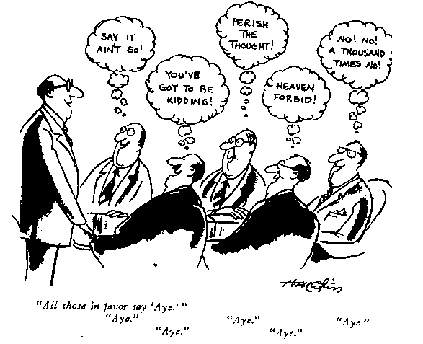
gro group polarization up polarization
Group polarization

Slide 29
Groupthink
Groupthink occurs when tightly knit groups place a higher valuation on consensus than on arriving at a good decision.
Members may squelch dissenting opinions or ignore or suppress contradictory evidence and come to feel that there is only one course of action to consider.
Example: In1961 a troop of Cuban exiles, directed by the United States, attempted to invade Cuba and start an uprising. This military operation, called the Bay of Pigs invasion, failed disastrously, embarrassing the united States and intensifying U.S./Cuban hostilities.
The decision to invade, made by President Kennedy and his military advisors, is considered to be a classic example of groupthink. Rather than considering all possible outcomes, the group convinced itself that the invasion could not fail.

Slide 30
Minority Influence
You might think that the majority viewpoint always wins out the in group decision making. However, minority viewpoints can sometimes win approval, particularly if the minority member…
Presents rational rather than emotional arguments.
Maintains a consistent position.
Shows confidence in the position.
Has patience.
Can win over at least one other member.
This is good news for the single voice in a group with opposing views. Over time, minority influences can lead to major social changes, such as desegregation or voting rights for women.

Slide 31
Group Roles
One way to help groups run smoothly is to assign different roles to different group members. (Think of a professional sports team…)
In some groups, roles may be formally assigned; in others, members may simply acquire them over time.
Consider these benefits of group roles:
Having distinct roles, including a group leader, establishes a structure or hierarchy for the group.
Roles allow for a division of labor and help clarify each person’s responsibilities and obligations.
Assigning clear roles can cut down on social loafing, because each person has a specific task for which he or she is accountable.
Group members may internalize their roles, thereby making them a part of their self-image.

Slide 32
Group Leadership
The success or failure of a group in attaining its goals may depend largely on the group’s leader, who defines goals, plans activities, and directs group efforts.
Common traits shared by successful business leaders:
Drive
Honesty and integrity
Leadership motivation
Self-confidence
Cognitive ability
Expertise
Creativity
Flexibility

Slide 33
Leadership Styles
Along with the leader’s personal traits, his or her leadership style – the leader works with the group – also affects the group’s success in attaining its goals.
Task-oriented leaders tend to focus on the work of the group members, supervising them as they go.
May be more effective in leading a group that is carrying out a specific job, such as building a clubhouse.
Person-oriented leaders tend to focus on giving group members emotional support and maintaining good interpersonal relationships within the group.
May be appropriate to help a group reach a consensus decision, such as what style of band uniform to choose.

Slide 34
Authority and Obedience
Obedience is the act of following orders given by someone is a position of authority.
From early childhood, we are taught to respect and obey authority figures, such as parents, teachers, police officers, employers, coaches, church leaders, and others.
Obedience to authority helps a society maintain order.
However, the Holocaust during Would War II, the My Lai Massacre in the Vietnam War, and the mass suicide-murders at Jonestown show the dark side of obedience.
Each clearly demonstrates how blind obedience to authority can cause people to commit horrific acts of inhumanity.

Slide 35
Why do we Obey Authority?
Studies suggest that most people have the capacity for blind obedience. Here are some possible reasons…
Most societies rely on hierarchies to provide social structure, organizational benefits, stability, peaceful relations, and group protection.
We are trained from birth to function within hierarchies, such as that of the family.
Authority figures have the ability to punish or reward us.
http://www.youtube.com/watch?v=W147ybOdgpE&safe=active
Milgrim’s Experiment

Slide 36
Why do we Obey Authority? Continued…
We have a desire to please authority figures.
When we obey authority
figures, we consider them (not
ourselves) responsible for any
consequences. We may say,
“I was just following orders.”
The scope of the orders may start in a small way and escalate only gradually.

Slide 37
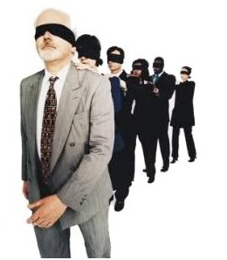
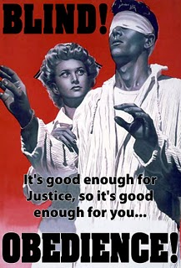
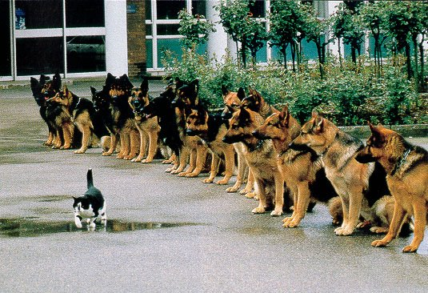

Slide 38
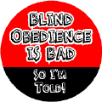
Personality Characteristics
Its easy to blame acts of brutality on a single “sick” individual who is not at all like us. However, the Holocaust could not have happened without the help of multitudes of ordinary people – law abiding citizens and good neighbors.
Zombardo’s Study (mock-prison experiment) suggests that most ordinary people will obey blindly – even if they are forced to act against their conscience, and even if they think
they are harming someone.

Slide 39
Helping Behavior
Helping others without expecting something in return is called altruism.
Are people generally altruistic?
Consider the following incidents that made the news…
In 1982 an airplane crashed in Washington, D.C., plunging into the icy water, one passenger repeatedly gave his lifeline to other passengers. They were pulled to safety, but the heroic passenger himself died.
In 1964 a woman named Kitty Genovese was stabbed to death in New York City while 38 neighbors watched from their windows. Although the attack took almost half and hour, no one came out to help or even call the police.

Slide 40
Why do we help?
The Kitty Genovese case shocked the nation and triggered a number of studies about why people help or do not help others. https://www.youtube.com/watch?v=BdpdUbW8vbw
The Bystander Effect: The Death of Kitty Genovese
Some of these studies suggest we are most likely to come to someone else’s assistance when:
The situation is clearly an emergency.
The victim is similar to ourselves.
We perceive that the victim did not bring the emergency on him or herself.
We know what to do or have some relevant expertise, such as knowledge of first aid.

Slide 41
Why do we help? Continued…
What causes us to help at all?
Some studies suggest that our desire to help others may have selfish motivations and that we do receive something in return.
Emotions
According to some researchers, helping others helps us feel good about ourselves or prevents us from feeling guilty that we didn’t help someone in need.
Genetics
Some social psychologists believe that humans may be “programmed” to help others because we are social beings. Over time, this helpfulness can help us to survive by strengthening social bonds.

Slide 42
Why Don’t We Help?
Media accounts of the day suggested that Kitty Genovese died because of the overall apathy and selfishness of American society.
To explore this issue, researchers Bibb Latane and John Darley brought subjects into the laboratory supposedly for purposes of market research. Then, either alone or with others, the subjects witnesses a staged emergency… screams from another room, the sounds of medical emergencies, or the sudden appearance of smoke.
What did researchers find?...

Slide 43
Why Don’t We Help? Continued…
The researchers were surprised to find that most of the subjects, when they were alone, responded to the emergency.
If they were among others, or thought that others were aware of the situation, they were much less likely to help.
In fact, as the number of participants increased, fewer and fewer of them responded.
Why did this happen?...

Slide 44
Why Don’t We Help? Continued…
Psychologists suggest the following explanations for this phenomenon:
Because many situations are ambiguous, we take our cues from others. EX: A fight between a man and a woman may be a mugging or a lovers’ quarrel. If other witnesses don’t respond, we don’t view it as an emergency.
When others are present, we worry about how they will judge our actions – or overreactions. We are inhibited because we don’t want to look foolish.
When alone, we feel a responsibility to act. When part of a group, we experience diffusion of responsibility. (The same responsibility exists, but it is spread over a number of people, so each one feels less responsibility.
We may assume that others are more knowledgeable or more capable of dealing with the situation than we are.

Slide 45
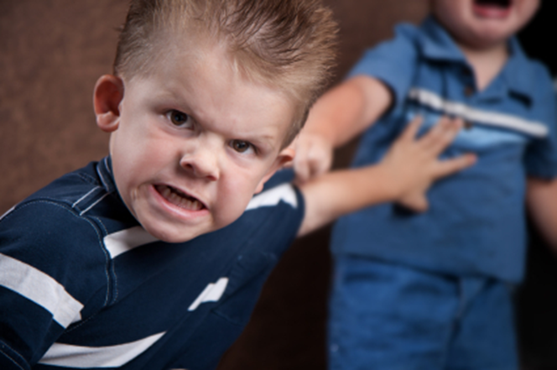
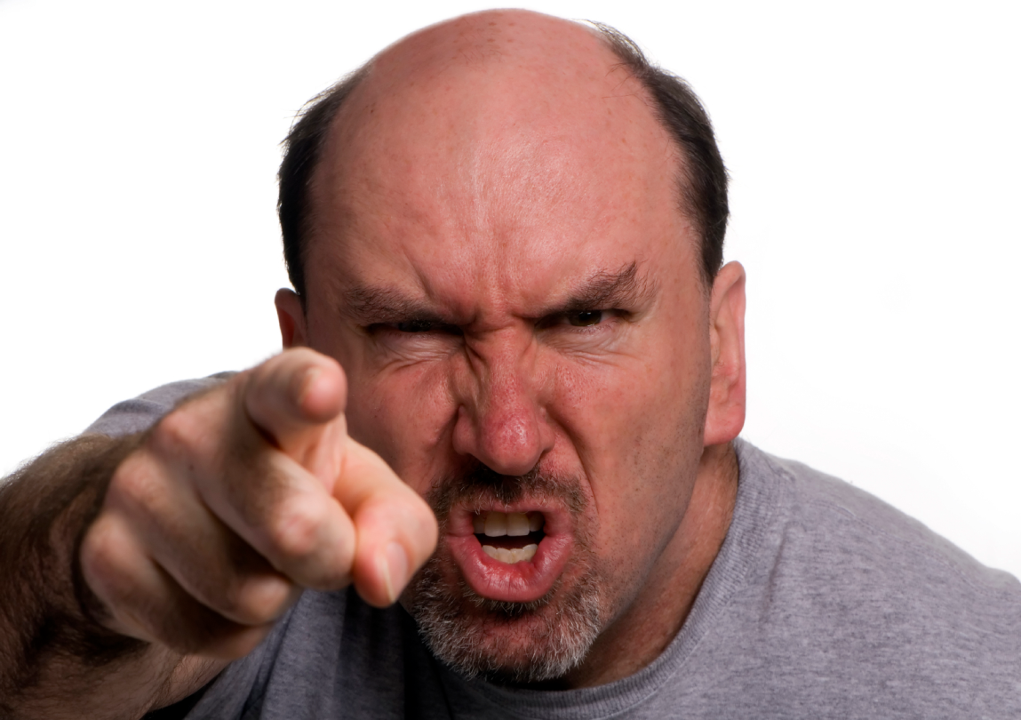
Aggression and Violence
In the wake of incidents such as the Columbine High School massacre, psychologists continue to debate the causes of aggression – behavior that is meant to harm someone.
Why are people aggressive?...

Slide 46
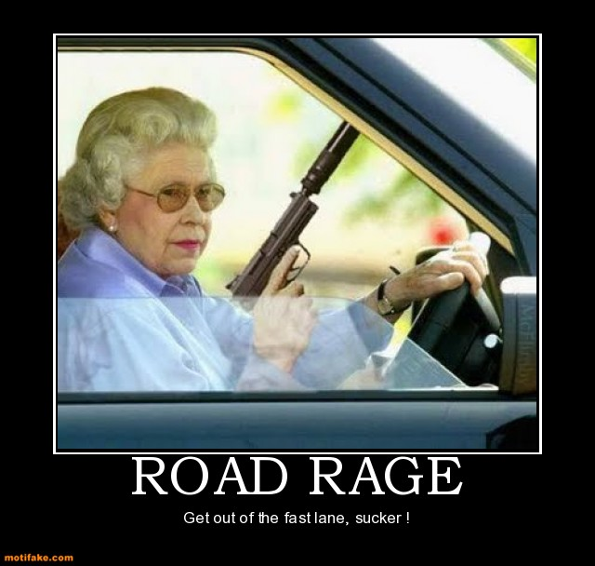
Frustration and Aggression
In the 1930s, a group of behaviorists developed the frustration-aggression hypothesis, identifying frustration as the cause of all aggression.
Road rage is an example
of aggression resulting
from frustration.
http://www.youtube.com/watch?v=lcqVXk4BT4A
While psychologists
agree that frustration
often contributes to
aggression, most no
longer believe that
frustration is the primary
cause.

Slide 47
Generalized Arousal
Imagine that as you are on your way to school, a car careens around the corner and you have to run to safety. Then, just as you get to the library, another student takes the last computer terminal. Ordinarily you would shrug it off, but today you find yourself tensing.
You may not connect the two incidents, but they may be connected just the same. Recent research suggests that strong physiological or emotional arousal may carry over from one situation to another.

Slide 48
Group Violence
What began as a peaceful political rally turns into a riot.
The home team wins a championship, and fans respond by overturning cars and clashing with the police.
Why does a group setting sometimes cause people to behave more aggressively than they would otherwise?
As we’ve previously discussed, groups often adopt a more extreme course of action than individuals.
In a process called deindividuation, people in groups become less aware of themselves as individuals and less aware of their own values and the social norms they usually follow.
Being in a group may impart a sense of anonymity. Without the threat of being judged individually, group members may lose their usual inhibitions.

Slide 49
Group Violence continued…
Groups such as the Ku Klux Klan encourage deindividuation by wearing hoods – increasing the sense that members are part of a group, rather than a collection of individuals.
Furthermore, wearing hoods assures anonymity.
These factors may contribute to a loss of inhibition against aggressive behavior.

Slide 50
Environmental Influences
Debates rage over whether the constant bombardment of violent images on television and in movies contributes to aggression in our society.
In one study, moviegoers emerging from violent movies filled out questionnaires designed to measure aggressive tendencies. They scored higher on these tests than those waiting in line to see the same movie.
In another study, young children were shown films of adults playing with an inflated doll. The children who saw the adults attack the doll were much more likely to do the same when given the inflated doll to play with.

Slide 51
Environmental Influences
Some long-term studies suggest that people who watched a lot of television violence as a child tend to show higher levels of aggression as adults.
In addition, people with aggressive tendencies seem to prefer violent programming.
This can lead to an endless cycle – people with aggressive tendencies watch more violent programming, which increases their aggressive tendencies, which leads to increased preference toward violent programming.

Slide 52
Environmental Influences Continued…
Researchers hypothesize that media violence contributes to aggressive tendencies because:
Viewing such materials raises an individual’s level of general arousal.
People, especially children, tend to imitate what they see.
Frequent exposure to media violence eventually desensitizes viewers.
Aggressive people tend to seek out aggressive material, which causes them to become even more aggressive.
Viewing aggressive material seems to weaken the viewer’s inhibitions against violence.
*These findings do not apply only to “shoot-’em-up” types of programs. Some studies indicate that watching aggressive sports events also increases aggressive tendencies.

Slide 53
The Freudian View of Aggression
Freud called aggression an inborn human trait.
Believed that people are ruled but two instincts: eros, an instinct for pleasure and love, and thanatos, and instinct for self-destruction, sometimes called a death wish.
He thought aggressive behavior was caused by the self-destructive instinct turning outward, toward others.
Freud also believed that aggressive energy builds up in people over time.
This energy had to be released through catharsis, or individuals would erupt in a violent outburst.

Slide 54
The Evolutionary View of Aggression
Other scientists, such as Konrad Lorenz, also proposed that aggression is inborn.
Unlike Freud, Lorenz looked for evolutionary connections, comparing human behavior with that of other animals.
He suggested that aggressive tendencies helped humans survive and were therefore passed down to succeeding generations.
Example: Aggressive tendencies might prove helpful in hunting, in acquiring a mate, or in defending territory and resources.
**However, opponents point out that if aggression were strictly an inborn human trait, all human societies should show it in an equal measure.
Murder rates of different societies suggest that this is not the case.

Slide 55
Biological Explanations of Aggression
A number of biological factors, including the following, can also affect one’s tendency to behave in an aggressive manner:
Higher levels of testosterone, the male sex hormone, seem to be related to higher levels of aggression in men.
Consuming alcohol seems to weaken inhibitions against aggressive impulses.
Drugs such as amphetamines can cause individuals to misinterpret external cues and attack others they perceive as a threat.
Chemical imbalances in the brain can keep a person from feeling empathy and other emotions that can inhibit aggression against others.

Slide 56
Learning and Cultural Explanations of Aggression
Most social psychologists today recognize learning and cultural training as important factors in aggression.
Example: children may be rewarded for aggression when they acquire a toy they want by bullying another child.
They may learn restraint when they are punished for aggressive behavior.
Children who grow up in abusive households are more likely themselves to adopt aggressive behaviors.
A cultures norms also plays a role.
Example: Little boys may be told that they should “be tough”, or “act like a man”.

Slide 57
Learning and Cultural Explanations of Aggression continued…
Overtime, we learn norms regarding…
What people or groups of people we can act aggressively toward.
What kinds of behavior by others deserve an aggressive response.
When or under what circumstances aggression is appropriate.

Slide 58
Ingroup bias - To illustrate how easily and quickly we form ingroups and outgroups, I divide my class into those wearing tennis shoes that day and those not wearing tennis shoes. Then I have each group sit in a circle with its members. The "tennis shoe" group is assigned to list as many reasons as it can think of as to why the members of the other group did not wear tennis shoes that day. The non-tennis shoe group is assigned to list as many reasons as it can as to why the other group members are wearing tennis shoes. The listing starts out fairly neutral, but it is not long before each group's list becomes more and more derogatory, particularly when it overhears the list the other group is generating.

Slide 59
YOUTUBE
Dangerous Conformity – Human Zoo
Philip Zimbardo: The psychology of evil
https://www.youtube.com/watch?v=BdpdUbW8vbw
The Bystander Effect – Human Zoo
Conformity Experiment
Invisible Rope Conformity Psych Experiment
Start at 7:19 « helper effect » Much Of What You Know About The "Bystander Effect" Is Wrong. | Ken Brown | TEDxUIowa

