Slide 1
The Gods Must Be Crazy
Material and Non-material Culture

Slide 2
Culture
The languages, beliefs, values, norms, behaviors, and material objects that are passed from one generation to the next; a way of life.

Slide 3
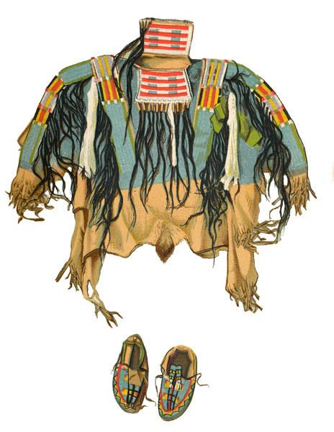
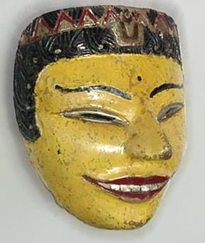
Material Culture
The material objects that distinguish a group of people, such as art, buildings, clothing, and jewelry. (cars, cell phones, yoga pants…)

Slide 4
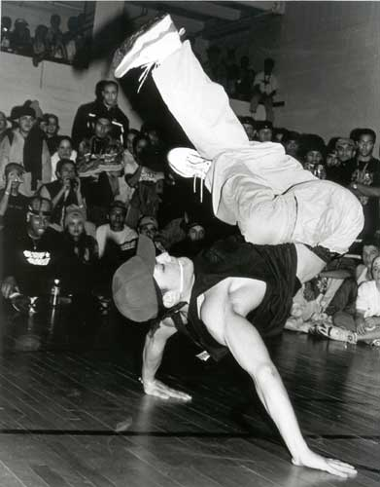
Nonmaterial Culture
A group’s way of thinking (values, beliefs) and doing (patterns of behavior, language, forms of interaction).

Slide 5
Cultural Relativism
Understanding a people from the framework of its own culture

Slide 6
Ethnocentrism
The use of one’s own culture as a yardstick for judging the ways of other individuals or societies, generally leading to a negative evaluation of their values, norms and behaviors.

Slide 7
Questions
Which of the following is a non-material characteristic of Bushman culture?
Clicking Speech
Never punish kids
Believe God’s give them only useful things
No sense of ownership
Snake skin pouch
Loin cloth
Bows and Arrows

Slide 8
When looking through the telescope, the Bushman asked “how did all of those people get in there?” This is an example of…
His ignorance
How one’s understanding of the world is limited to their experience
Cultural Relativism

Slide 9
How does the introduction of new “technology” change the Bushman culture?

Slide 10
Borg 3 of 5

Slide 11
Cognitive dissonance
is a discomfort caused by holding conflicting cognitions (e.g., ideas, beliefs, values, emotional reactions) simultaneously.
In a state of dissonance, people may feel surprise, dread, guilt, anger, or embarrassment. The theory of cognitive dissonance in social psychology proposes that people have a motivational drive to reduce dissonance by altering existing cognitions or adding new ones to create consistency

Slide 12
For instance, someone may take home office supplies.. they know its wrong and can get in trouble if caught, but they alleviate their feelings of doing anything wrong by justifying that they don't get paid enough, or that there are so many surplus supplies lying around wasting ... etc. or even eating a grape in the produce department! its WRONG but we tell ourselves.. we are sampling to ensure they taste right... then oftentimes not even purchasing them. (I do NOT do this... :P) Or someone speeds on the way to work... they know they are breaking the law, but in their mind they tell themselves its more important to get to work on time. or even say.. someone you dislike greatly does something very generous towards you...it makes you feel awkward and weird because you dislike that person..maybe you write it off as them doing it on purpose to make you feel bad for hating them!

