Slide 1
Industrial Revolution
New Ways of Thinking

Slide 2
Re-Cap
What problems arose during the Industrial Revolution?
The transition from agriculture to urban industry was …
What was done because of this?
Eventually people demanded better working conditions through:
Labor unions = better hours and working conditions
Child labor laws
The right to vote (first men and then women)

Slide 3
New Ways of Thinking
As a result of a rapidly changing lifestyle, people turned to different ideas to help explain what was happening and untimely what should happen.
Where do you think these ideas came from?
Notes:
The Enlightenment, the French, American and Latin American Revolutions, Global Exploration…

Slide 4
New Ways of Thinking
The different ideas that became prevalent during the Industrial Revolution can be divided into two main categories. These are still debated today.
1. Laissez -Faire Economic Capitalism
2. Socialism

Slide 5
Laissez-Faire Economics
Laissez-Faire is a French term that means “let do”, or “leave it [economy] alone”
Laissez-Faire economists call for the government to keep its “hands-off” the economy
Famous Laissez-Faire economists to know:
Adam Smith (Father of Capitalism)
Thomas Malthus (Population)
David Ricardo (Iron Law of Wages)

Slide 7
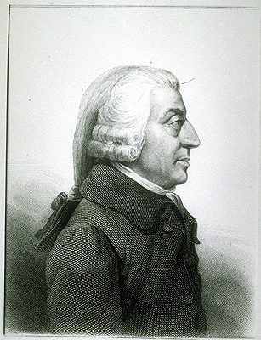
Adam Smith - Father of Capitalism
Believed that the unregulated exchange of goods and services would eventually help everyone
A free market will allow for more goods at lower prices
A growing economy encourages capitalists to invest in new business which creates jobs
Pointed to the success of the Industrial Age - which had no/little government interference

Slide 8
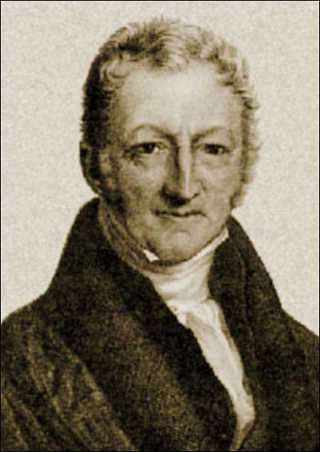
Thomas Malthus on Population
Believed population would outpace the food supply
Believed that war, famine, and disease kept populations under control
Urged families to have fewer children (especially the poor)
Early on, people believed this but his predictions proved to be false. Food supplies grew even faster than population.

Slide 9
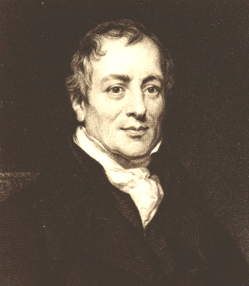
David Ricardo - Iron Law of Wages
Also believed the poor had too many kids
Believed in a cycle of poverty:
When wages are high people have more children
When there are more people to hire, wages go down
When wages are lower, and there are too many people, unemployment is high
Believed the poor/middle class could never escape poverty

Slide 10
Utilitarianism
A revision of Laissez-Faire economics
Allowed for government interference in the economy
Believed the goal of society should be to provide the greatest happiness (utility) to the greatest number of people
Supported individual freedom (provided happiness)
Supported government involvement to help the struggling middle class
Called for giving the right to vote to working men and women Right to vote = suffrage

Slide 11
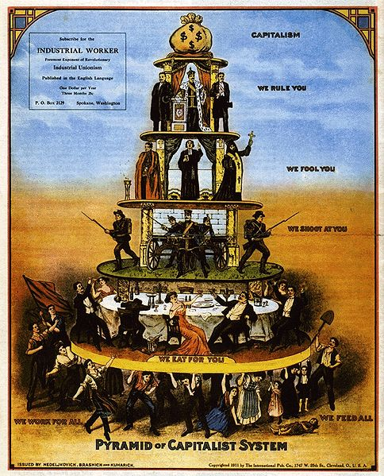
Socialism…
People control
production and
distribution of
goods and
services.

Slide 12
The Socialists
Allowed for government interference in the economy on three different levels
1. UTOPIAN SOCIALISM-peaceful, set up of communities which share work and profit, no vote by people
2. DEMOCRATIC SOCIALISM- people are informed of advantages, vote for this type of socialism, still in practice in West Germany, Sweden, Israel, and during part of the twentieth century in Great Britain.
3. SCIENTIFIC SOCIALISM-part of the system of communism this calls for violent revolution by the proletariat to defeat the capitalists .
Today: All call for some or complete government ownership and control of business.

Slide 13
Utopian Socialism
Valued the good of society over individual rights
Believed capitalism created a divide between rich and poor
Believed that instead of individual business controlling the means of production, society as a whole should
Goal of socialism is to make society better off at the expense of freedoms

Slide 14
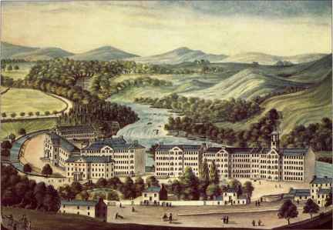
Robert Owen
Owen set up a Utopia in New Lanark Scotland where he transformed life with ideas and opportunities which were at least a hundred years ahead of their time. Child labor and corporal punishment were abolished, and villagers were provided with decent homes, schools and evening classes, free health care, and affordable food.
Socialist AND business
owner
Refused to use child
labor
Campaigned for child
labor laws and labor unions

Slide 15
Scientific Socialism - Karl Marx
German philosopher that teamed with another socialist - Friedrich Engels to write the Communist Manifesto
Believes that economics is the driving force in history
A constant struggle between “haves” and “have-nots”
Believed that the “haves” have always controlled society (called the bourgeoisie)

Slide 16
-The “have-nots” are called the proletariat and are the working and poor class -Hated capitalism because he believed it called for a few to be rich, while the rest were poor -Believed that in the end the proletariat would overthrow the bourgeoisie and create a communist (class-less) society where wealth is equally shared

Slide 17
Marx said that the workers would rise up and stab the owners with their pitchforks…
Ok, so he didn’t say that, but he said that the continued divide between the haves and the have not's would end in a bloody revolution.

Slide 18
And that private property would cease to exist.

Slide 19
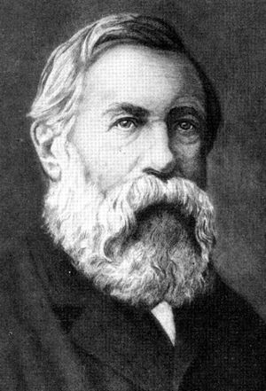
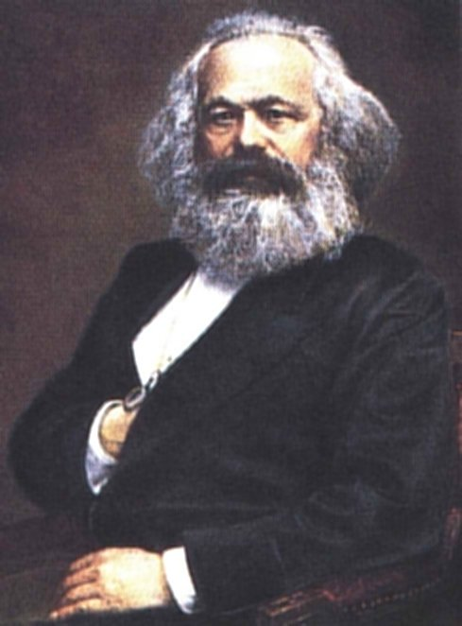
Name that economic philosopher of the late 1800 and your favorite biology teacher at CHS…

Slide 20
Communism like Marx discussed…
We have never really seen in the world.
Maybe China, Russia, and Cuba, but those didn’t look like what Marx talked about

