Slide 1
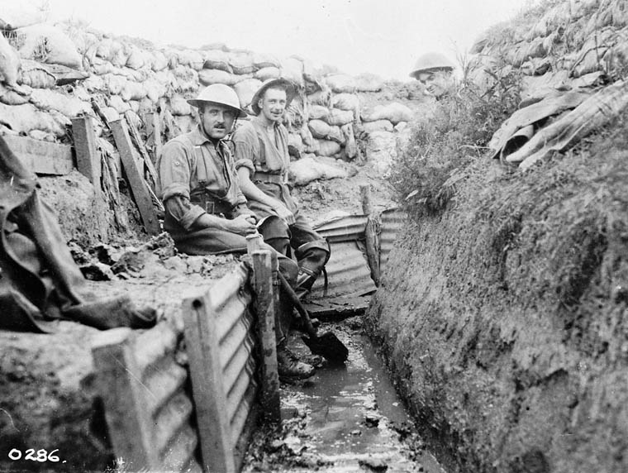
34. Define the following types of warfare: Trench Guerilla Nuclear Biological
form of occupied fighting lines, consisting largely of trenches, in which troops are largely immune to the enemy's small arms fire and are substantially sheltered...
Trench Warfare

Slide 2
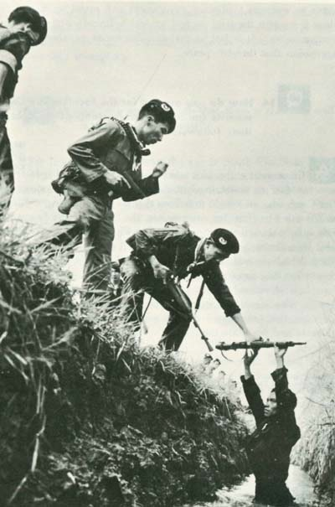
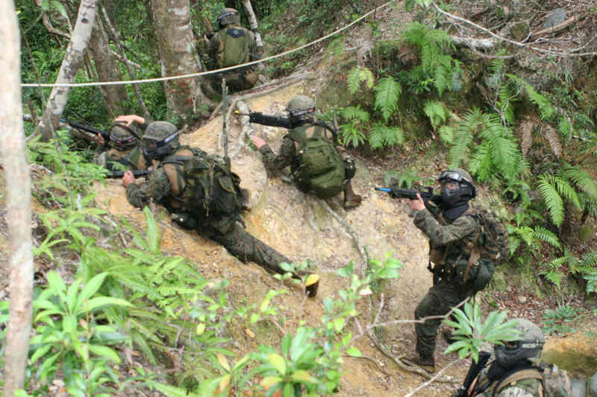
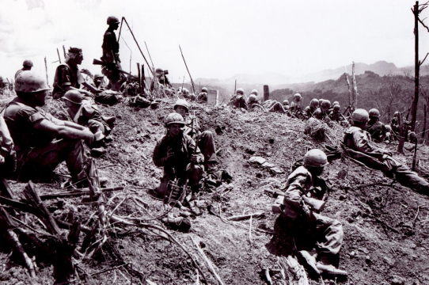
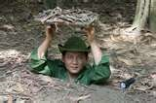
34. Guerilla (p. 637, 767, 891, 868)
Hit and Run Tactics
Benefits those with the home field advantage
if you know the land, you can outsmart the opponent
Used in Korea, Vietnam, and parts of Latin America
Hit and Run
Notes:
form of irregular warfare and refers to conflicts in which a small group of combatants including, but not limited to, armed civilians (or "irregulars") use military tactics, such as ambushes, sabotage, raids, the element of surprise, and extraordinary mobility to harass a larger and less-mobile traditional army, or strike a vulnerable target, and withdraw almost immediately.

Slide 3
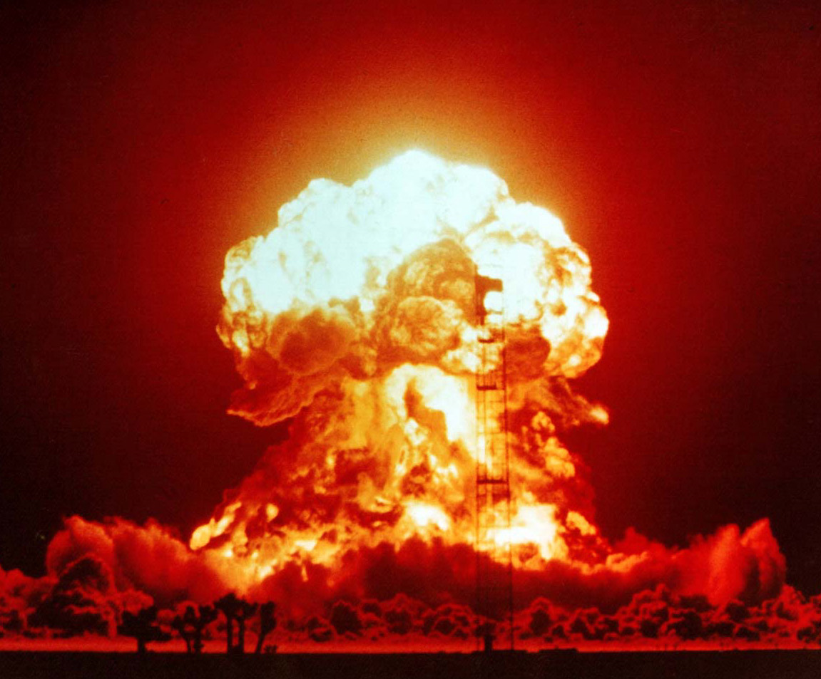
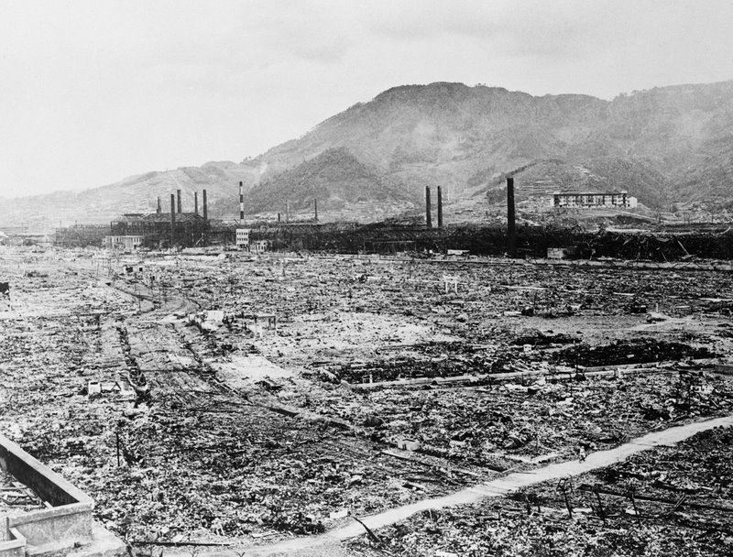
34. Nuclear warfare (p. 806-7, 848)
atomic warfare, is a military conflict or political strategy in which nuclear weaponry is detonated on an opponent.

Slide 4
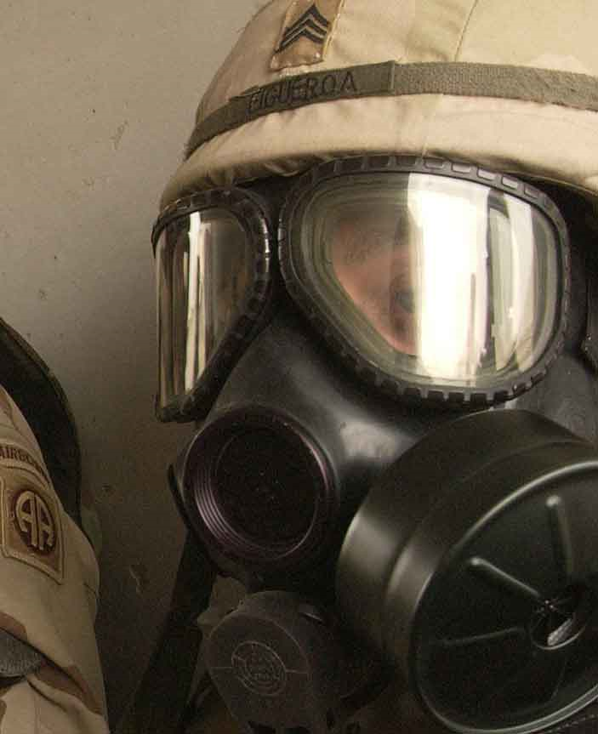
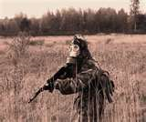
34. Biological (see notes)
weapons include any organism (such as bacteria, viruses, or fungi) or toxin found in nature that can be used to kill or injure people.

Slide 5
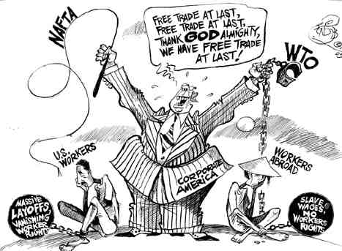
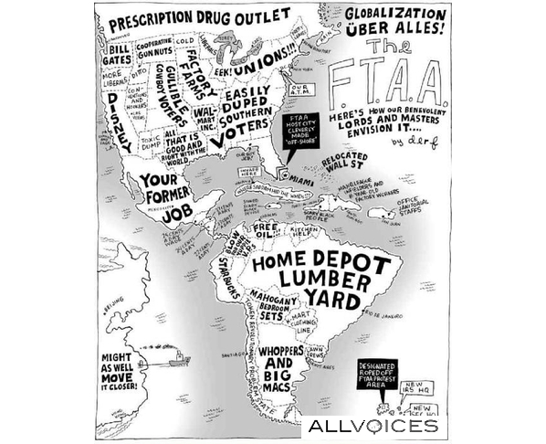
35. Define interdependence. (p. 828)
dependent on other nations for needs like raw materials or markets
Increased after the Industrial Revolution

Slide 6
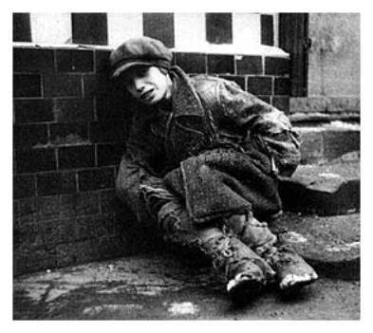
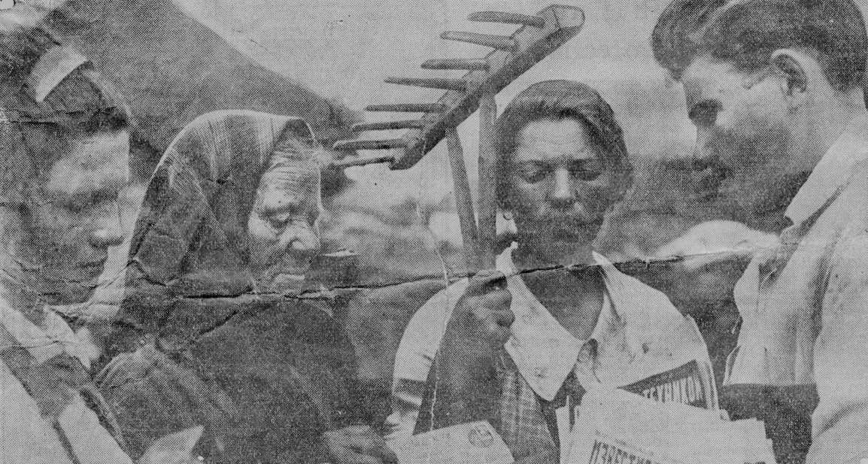
36. What conditions allowed for the rise of totalitarian dictatorships in the period between WWI and WWII? (p. 766, 776-7)
Weak and unstable governments and economies
Stalin promised Peace, Bread and land
Hitler’s promise of
“work and bread”

Slide 7
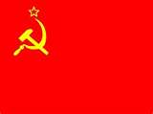
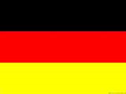
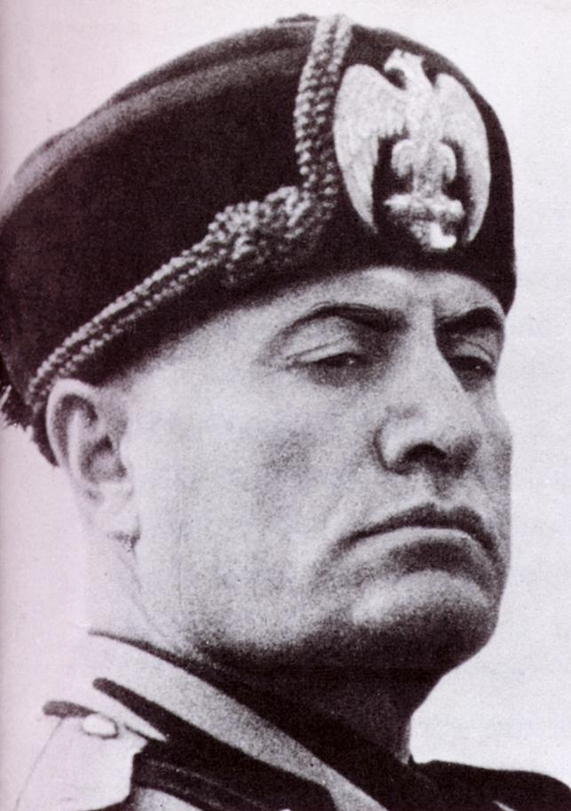
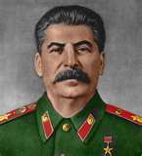
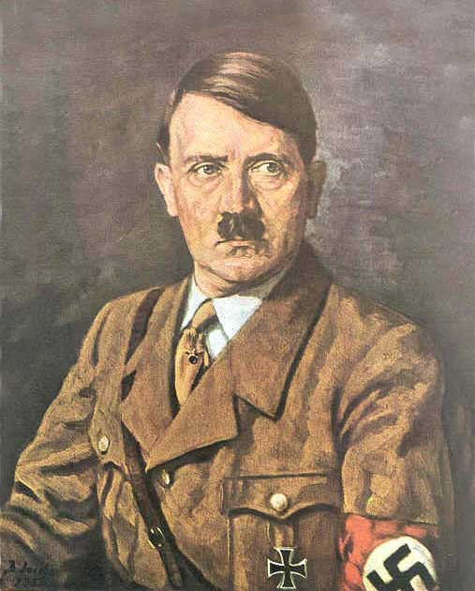
37. Name three totalitarian dictators and the country they led. (p. 777)
Russia Germany Italy

Slide 8
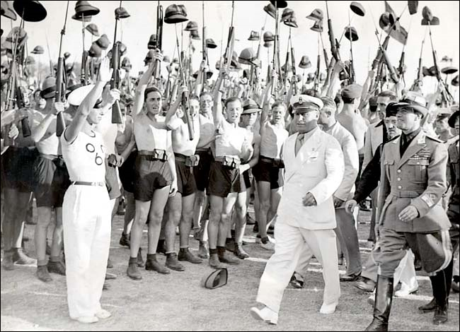
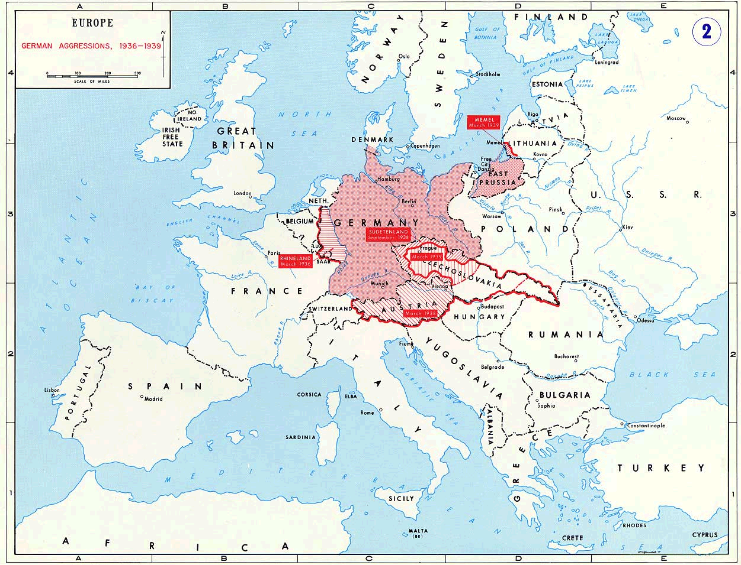
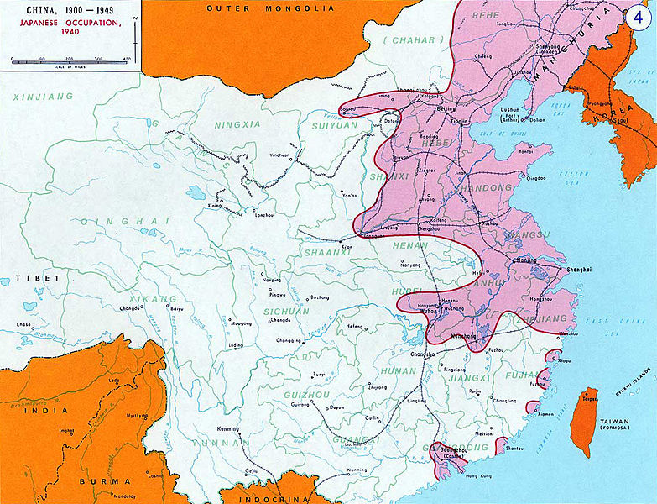
38. Give examples of the aggressive actions of Japan, Italy and Germany during the interwar period between WWI and WWII. Japan: (p. 788) Italy: (p. 788-789) Germany: (p. 781-789)
German aggressions during the interwar period
Japanese invasion of China
Mussolini marching into Ethiopia

