Slide 1
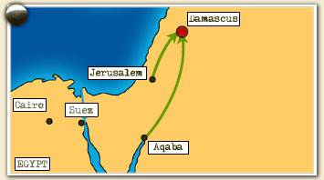
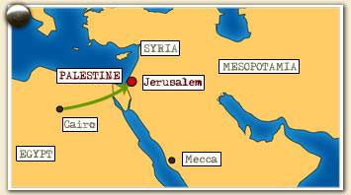
65. Why was the state of Israel established after World War II? (p. 907)
The same land was promised to both groups after WWII
Jews helped the Allied
Advance Against the Ottoman Turks
The British & Arab Armies
The Jews needed a homeland after holocaust.
Notes:
Needed a homeland after holocaust

Slide 2
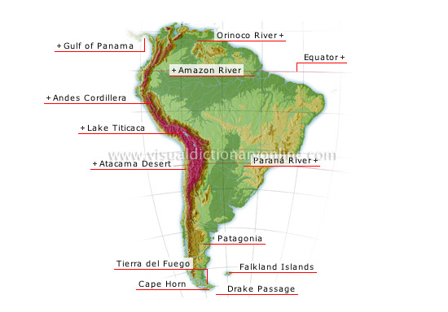
66. What are some of the major geographic features that have influenced South American economic and political development? (p. 951, 953, 959,960, 962)
Location near the equator
Rivers, rainforests, port cities, mountain ranges, deserts…

Slide 3
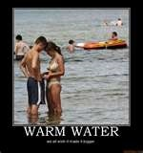
67. Due to its location, Russia needs and has traditionally sought access to what kind of geographic feature? (p. 441)
For nearly two hundred years, the policy of obtaining, maintaining, and increasing a seaboard has been consistently followed.
warm water ports can be of great geopolitical or economic interest,
Russia needed a warm water port to have a well rounded economy like China or America..
Notes:
A "warm water port" is a port where the water does not freeze in winter. Because they are available year-round, … As the Russian empire expanded to the East, it would also push down into Central Asia towards the sea, in a search for warm water ports

Slide 4
68. How has the role of the North Atlantic Treaty Organization (NATO) changed since the end of the Cold War? (p. 812)
Russia is a NATO partner
heading the fight against Momar Gaddafi of Libya
Have taken on the role of world police…
stresses dialogue and partnership with the emerging democracies in the former Warsaw Pact
-- Stresses that the fundamental purpose of nuclear weapons is to preserve the peace.
Notes:
-- NATO no longer considers the former Soviet Union to be an adversary; and NATO does not seek to isolate any country in the former Eastern bloc; and
NATO also seeks stability and security in Europe through its new Strategic Concept which:
-- Identifies the changing European security landscape,
stresses dialogue and partnership with the emerging democracies in the former Warsaw Pact;
-- Notes the importance of addressing, for the first time, security threats beyond the NATO area, and establishes the basis for peacekeeping and coalition crisis management operations as important NATO missions;
-- Restructures the forces and missions of NATO's integrated military commands to better deal with Europe's new security environment by focusing on peacekeeping and cooperative military efforts open to all European states willing to participate;
-- Stresses that the fundamental purpose of nuclear weapons is to preserve the peace.

Slide 5
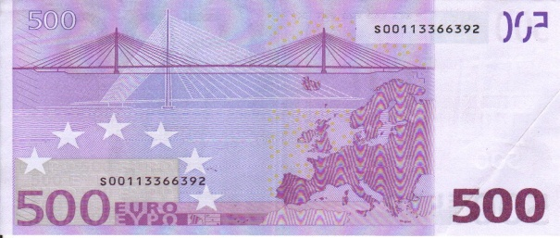
European Union (EU)
69. What are the economic goals of the European Union? (p. 851)
-EU: An organization of European countries that promotes free trade among member nations. The goal is to improve the economy in Europe.
The Euro
-17 out of the 27 EU members use the same money called the Euro. – Why would they want to use the same money?
-The Euro is worth more than the
U.S. dollar. (1 Euro = $1.42)

Slide 6
70. What region in the world exports the greatest amount of oil? (p. 832, 907, 908 chart)
The Middle East and North Africa

Slide 7
71. What are some of the components of the United Nations? (For example, the UN includes the International Court of Justice.) (p. 828)
Did You Know?
UNICEF vaccinates 40 per cent of the world’s children, saving 2 million lives a year.
UN relief agencies provide aid and protection to over 34 million refugees and others fleeing war, famine or persecution.
Since 1945, the UN has assisted in negotiating more than 170 peace settlements that have ended regional conflicts.
The UN played a role in bringing about independence in more than 80 countries that are now sovereign nations.
The UN has 4 main purposes
To keep peace throughout the world;
To develop friendly relations among nations;
To help nations work together to improve the lives of poor people, to conquer hunger, disease and illiteracy, and to encourage respect for each other’s rights and freedoms;
To be a centre for harmonizing the actions of nations to achieve these goals.
International Court of Crimes tries people guilty of committing war crimes and atrocities.
Security Council

Slide 8
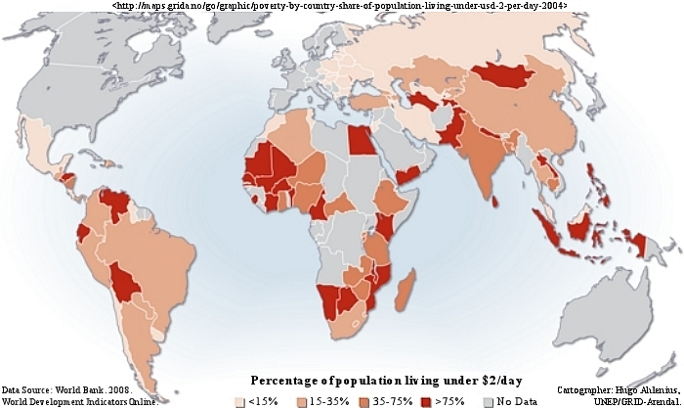
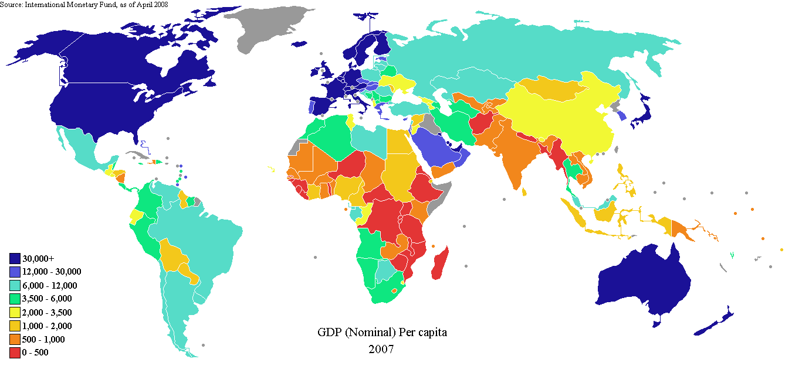
72. What are some of the problems facing developing nations today? (p. 833-837, 836 chart)
struggles in developing nations

Slide 9
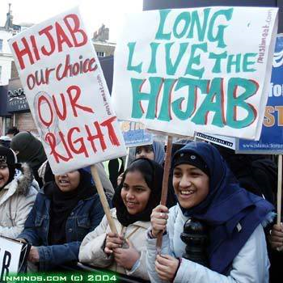
73. How has Islamic fundamentalism influenced and impacted modern societies? (p. 910-911)
Based largely upon the principles of Islamic fundamentalism that were gaining momentum throughout the Arab world in the 1980s
Opposed to the West’s influence related to modernization
Goes against traditional culture
Has lead to terrorism
Notes:
Hate west and modernization/influence on their traditional culture … terrorism

Slide 10
74. What is the impact, or role of, interdependence and modern technology on the global economy? (Chapter 32 interdependence, p. 841-843 technology)

Slide 11
What has been the impact of the computer on the global market?
Countries are more interdependent
Makes the world “smaller” in that we can connect more easily
Less reliant on stores to acquire merchandise
Causing some businesses to collapse while others start and strive

