Slide 1
The Beginnings

Slide 2
Pre-History
Archeologists study
Time before a written record
Look to artifacts for information

Slide 3
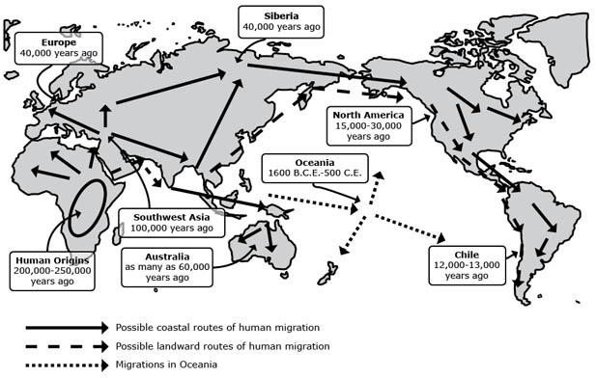
African Beginnings
Archeologists have found evidence of the first humans in East Africa.

Slide 4
Paleolithic Period
A.K.A. – Old Stone Age
Nomadic Bands
Hunting and Gathering
Adapted to surroundings
Tools and Weapons from stone, bones, and wood.
Developed a spoken language.
Cave paintings
Art and Religion
Lascaux Cave Paintings

Slide 5
The Breakthrough
What do you think is the breakthrough?

Slide 6
Agricultural Revolution
11,000 years ago
Farming
Moved from Paleolithic to Neolithic Age
Neolithic Age – a.k.a. New Stone Age

Slide 7
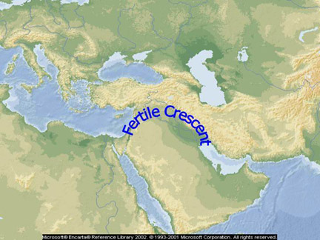
The Fertile Crescent
Region of the World where it is believed that farming began.

Slide 8
Changes from Paleolithic to Neolithic Age
Sedentary Lifestyle
Stayed in one place
Domestication of Animals
Tame animals for the benefit of humans.
People became food producers

Slide 9
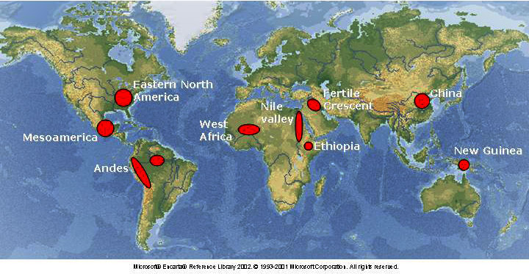
Areas of the World where farming communities began.

