Slide 1
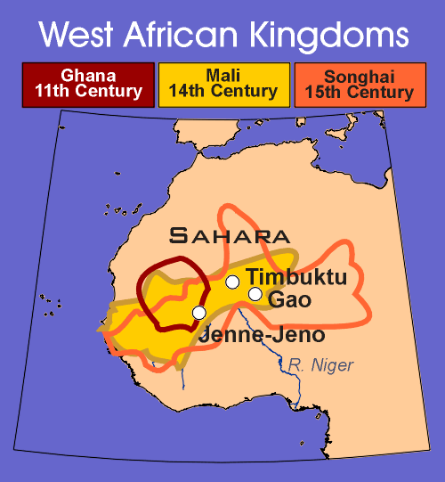
The West African Empires of Ghana, Mali and Songhai

Slide 2
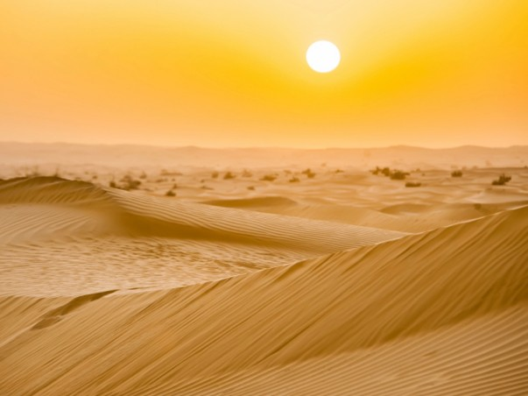
If Europeans traded with China, why do you think they didn’t trade with Africa?

Slide 3
I can explain the importance of gold and salt in west Africa. I can also explain the rise and fall of Ghana.

Slide 4
Ghana
Grew Rich because of the Gold and Salt trade
Muslim traders and missionaries bring Islamic faith to Western Africa across Trans-Saharan trade routes.
King allowed Muslims to settle
However, he did not convert to the religion
Tolerance shown by Muslims toward traditional religious practices
Helps Islam to spread in West Africa
Declined when attacked by Muslim warriors for natural resources

Slide 5
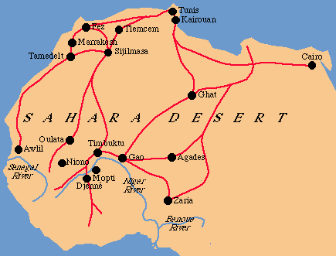
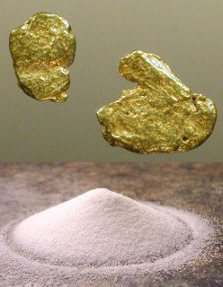
Trans Saharan Trade Routes

Slide 6
The Kingdom of Mali
The 1st great Muslim state in West Africa

Slide 7
CA Standard(s)
7.4-1: Study… the growth of the Mali empire.
7.4-3: Describe the role of the trans-Saharan caravan trade in the changing religious & cultural characteristics of West Africa & the influence of Islamic beliefs, ethics, and law.
7.4-4: Trace the growth of the Arabic language in government, trade, and Islamic scholarship in West Africa.

Slide 8
Mali
Was extremely wealthy from the gold and salt trade
Mande conquer Kumbi (center of trade in Ghana) – takes control of trade routes and establishes Empire of Mali.
Leaders accept Islam
Do not follow all teachings

Slide 9
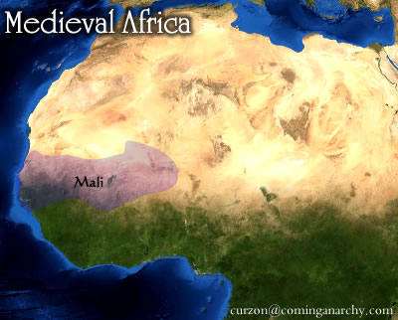
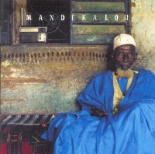
I. The Kingdom of Mali was established by the Mandé people around the 1200’s
Mandé: These ppl established the Kingdom of Mali

Slide 10
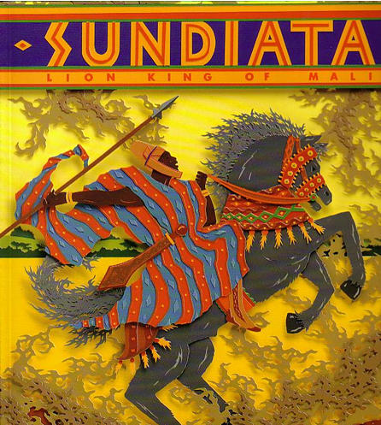
A. A great man named Sundiata originally created the Kingdom of Mali after conquering nearby cities
Sundiata: The man who will create the Mali Empire

Slide 11
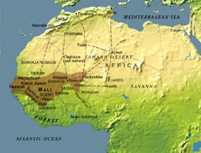
Mansa Musa
First West African leader to practice Islam devoutly. He had a good understanding of the Arabic language.
Mali becomes major crossroad of Islamic world.
Makes a hajj (pilgrimage to Mecca)
Led to Mali becoming known as an important kingdom in Europe.

Slide 12
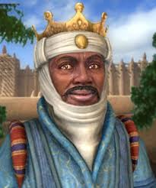
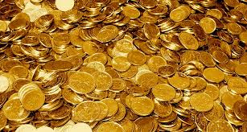
A Grand Journey
Mansa Musa’s journey to Mecca was almost four thousand miles, it took years to prepare!
He had thousands of people attending him along the way
When he stopped in Cairo, Egypt he gave away so much gold that the value of gold went down for almost a decade.

Slide 13
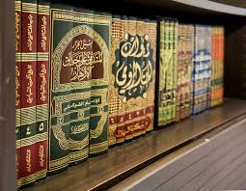
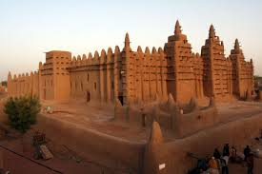
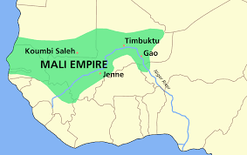
The results…
When he came back from his trip he brought Arab scholars, government officials, and architects.
Mansa Musa built mosques, libraries, and universities in Mali spreading learning throughout his empire (Islam spread through West Africa
His pilgrimage also brought Mali to the attention of the Europeans, they were put on European maps.

Slide 14
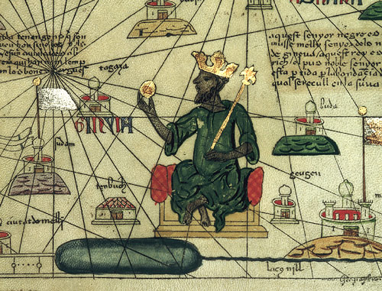

Slide 15
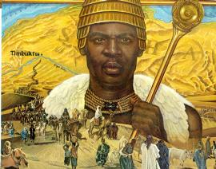
Here’s the full list of the ‘26 richest people of all time 1. Mansa Musa I, (Ruler of Malian Empire, 1280-1331) $400 billion

Slide 16
Read and Draw
Oral Tradition~ Importance of remembering what you heard, this is how African history was shared.
Expect to be frustrated, then move on. Don’t get stuck. We are learning about oral tradition and about ourselves as learners!☺
Try to stay focused on the fact that we are learning about Mansa Musa.

Slide 17
http://www.youtube.com/watch?v=jvnU0v6hcUo&safe=active
Mansa Musa and Islam in Africa: Crash Course World History #16

Slide 18
Songhai
Group within Mali
Great Warrior Sunni Ali
Builds powerful army, breaks away and conquers Mali.
Under Askia Muhammad
Centralizes the government
Collapse of Songhai Empire
Moroccan fighters equipped with gunpowder and cannons & quickly defeated Songhai warriors.
Ends a time period when powerful empires ruled over Western African.

Slide 20
Influence of Islam on West Africa

Slide 21
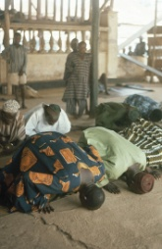
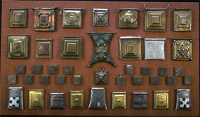
Religious Practices
Adopted traditions from Islam
Preserved old practices
Show respect for spirits of dead ancestors
Belief in spirits
Use of amulets (charms) to help them or protect them.
Learned Five Pillars of Islam
Use of Arabic language
Fasted
Worshipped in mosques
Hajj
Gave alms

Slide 22
Government and Law
Succession becomes paternal
Centralization of King’s authority
Title of sultan or Amir
Adopted shari’ah (Islamic law)

Slide 23
Emphasis on Education
Timbuktu – important center of learning
Several Universities
Most famous – University of Sankore
Qur’anic schools
To instruct children in the Qur’an
Treasured books
No printing press – had to be hand copied.

Slide 24
Arabic Language
Arabic becomes language of religion, learning, commerce and government.
Use native language in everyday life.

Slide 25
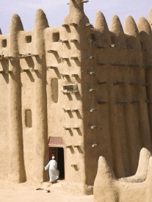
Architectural Styles
Building of mosques
Built out of mud and wood – as those are the available resources for construction
Rectangular houses
Flat roofs and geometric designs on the doors
Clay drain pipes – move water away from houses

Slide 26
Decorative Arts
Calligraphy
Geometric patterns
Textiles = Cloth

